Slide 1
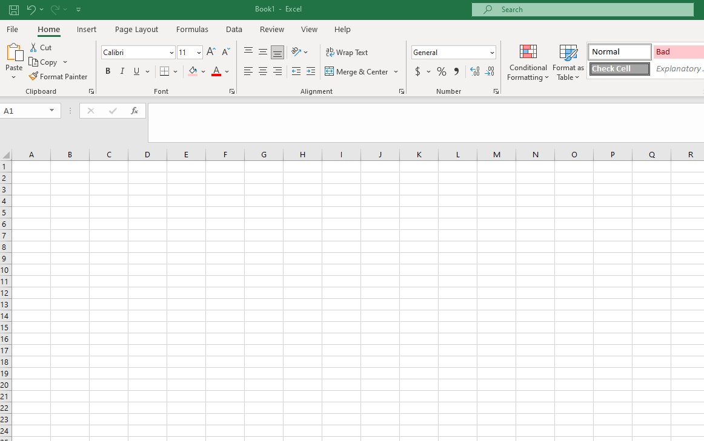
Excel Basics
April 20, 2022

Slide 2
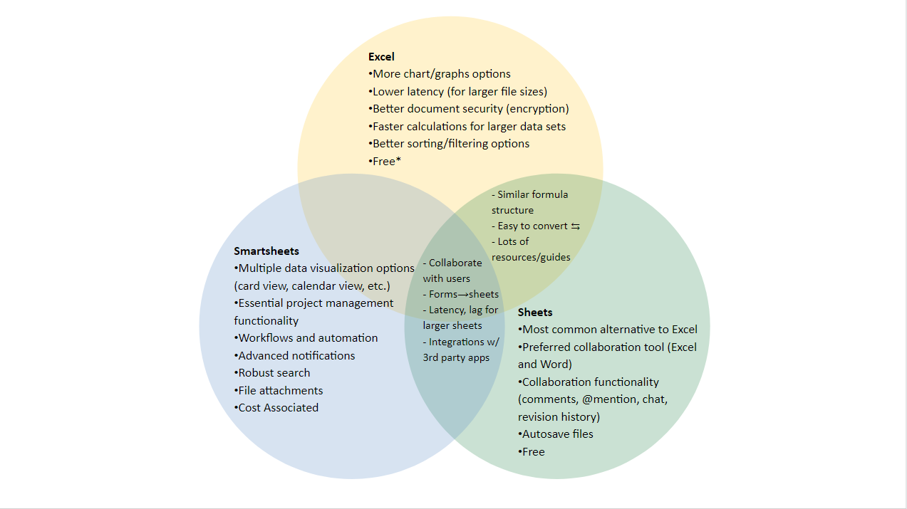

Slide 3
LEARNING OBJECTIVES
Create a new sheet (create, rename and move tabs)
2) Format cells and add filters
3) Input Basic Formulas (sum, average) and add absolute cell references

Slide 4
Create a New Sheet
Create tabs
Rename tabs
Move tabs
→DEMO in excel

Slide 5
Format cells and add filters
Autofit cells to content size, wrap text, merge cells, cell borders and shading, adding a column or row
Change cell format to display correct values
Add data filters and sort data
→DEMO in excel

Slide 6
Input Basic Formulas, add absolute cell references and shortcuts
Sum, Average, Round, Concatenate, Proper
Change cell format to display correct values
Absolute cell references
Keyboard shortcuts (highlight all, copy, paste)
→DEMO in excel
→PDF with shortcuts as handout

Slide 7
Questions?

